Slide 1
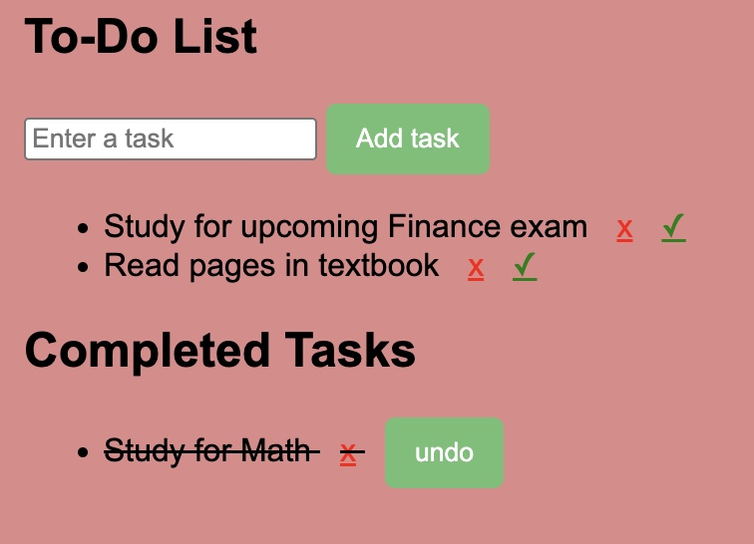
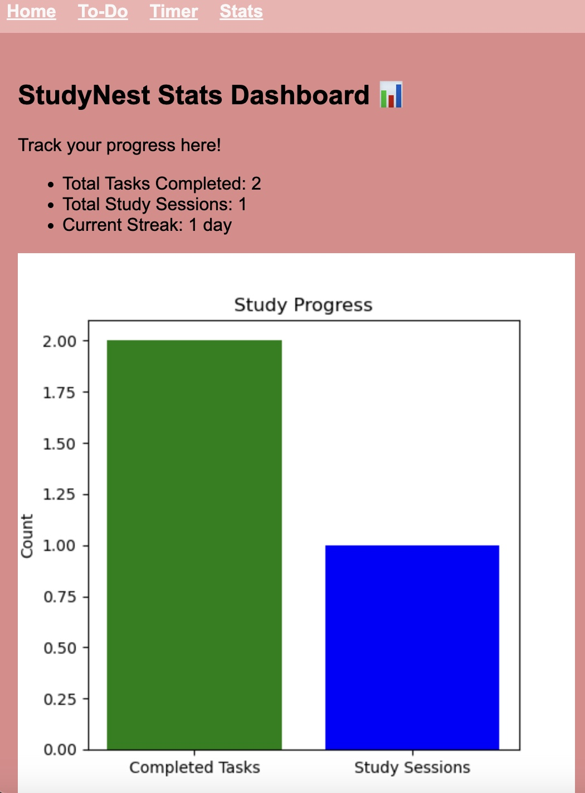

Study Nest Kristin Turner
Keep up with your tasks, time, and progress – all in one place. Study Nest is a website that helps students stay organized by tracking tasks, study sessions with a timer, and progress.

